Slide 1

CSE 499A: Senior Project Design
Member-1: Md Naimul Islam Suvon
Id: 1712252642
Member-2: Mehebuba Ferdous
Id: 1620600042
Date: 21st October 2019

Slide 2
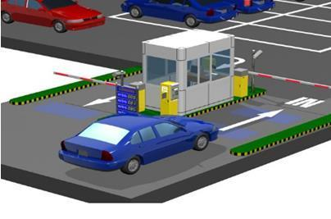
AUTOMATED PARKING MANAGEMENT SYSTEM USING DEEP LEARING METHODS

Slide 3

Past & Related Work
Number Plate Recognition for use in different countries using an improved segmentation , Conference Paper in March 2011 by Debarshi Patanjali Ghoshal McGill University
“Bangla License Plate Recognition Using Convolutional Neural Networks (CNN)” Undergraduate Thesis Paper by M M Shaifur Rahman, December 24, 2017

Slide 4
Motivation
A Complete Project with it´s application
Using Hardware and Software Both
Use of Mathematical Model ,Learn Python the Hard Way ,Book by Zed Shaw

Slide 5
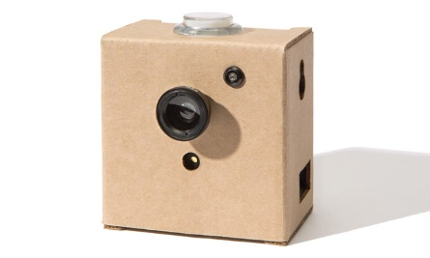
Proposed Work
NO
Capture Frame
Image Processing
Recognize Number Plate
Start
YES
END
Plate Extraction
Web or Desktop Application
Store in Database
Character Output
Recognize Bangla Characters

Slide 6
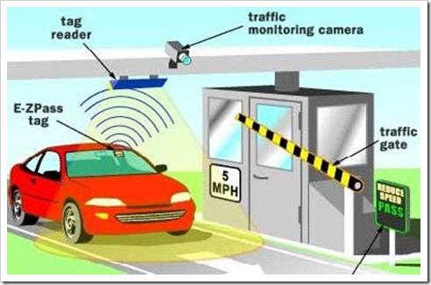
ELECTRONIC TOLL COLLECTION SYSTEM USING RFID TECNOLOGY

Slide 7
Past Work
Barcode-based Electronic Toll Collection System
Calm active infrared
VPS-technique (Vehicle Positioning System)
RFID-based Electronic Toll Collection System

Slide 8
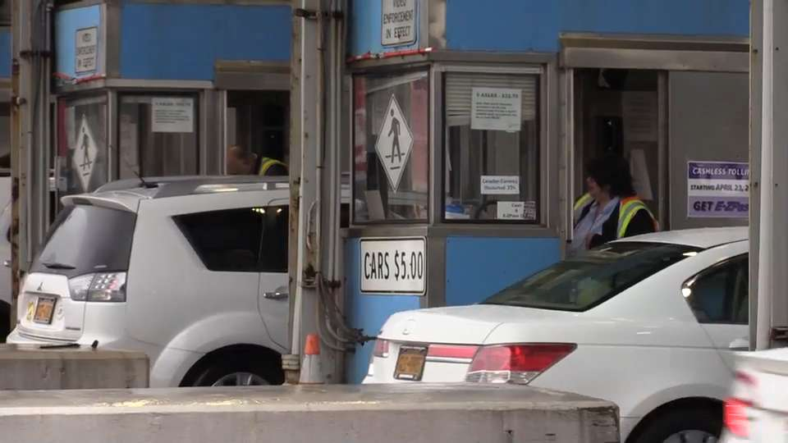
Motivation
Reduce Traffic Problems
Transparency of the toll collection system
Time consuming
Figure 1: Manually toll collection system

Slide 9
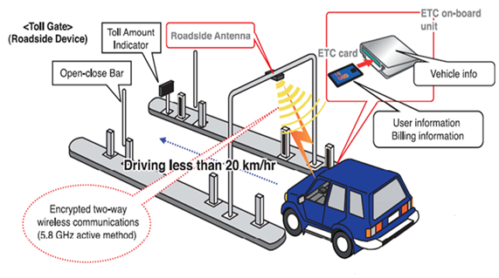
Proposed Contribution
Introduce Electronic Toll Plaza in Bangladesh
To compare various aspects of this existing system with the electronic toll collection system
To find out the economic benefits of introducing Electronic Toll Collection
Figure 2: RFID technology for Electronic Toll Collection

Slide 10
THANK YOU

